Slide 1
Thinking About Thinking About the Research Paper
Engaging Metacognition throughout the Student Research Process
Zoe Fisher, Assistant Professor
Pedagogy & Assessment Librarian
University of Colorado Denver
Auraria Library
Metacognition & Mindfulness Conference
Renton Technical College
March 10, 2017

Slide 2
About Me
Reference & Instruction Librarian at Pierce College, 2012-2016
Completed Reading Apprenticeship training at WestEd in Oakland, Ca. in June 2013
Pedagogy & Assessment Librarian at the University of Colorado Denver, July 2016 to Present
Image courtesy of Auraria Library

Slide 3
Today’s Outcomes
By the end of today’s workshop, you will be able to…
Identify RA routines to use at various points in the research process
Model and practice RA routines to use in the classroom
Reflect on how to integrate RA routines into existing research paper assignments

Slide 4
What do we mean by “research paper”?
Image courtesy of Unsplash.com

Slide 5
In this context, a research paper is…
Any writing assignment that requires students to locate and use outside sources of information as evidence to support their ideas and claims.

Slide 6
Introductions

Slide 7
Introductions
In pairs or groups of 3, introduce yourself & include:
Your role & where you work
The reading struggles you see in your students’ research and writing habits
Image courtesy of Unsplash.com

Slide 8
Visualizing the Research Process

Slide 9
What is the path our students take?
Consider the research process from a student’s perspective, beginning when they receive an assignment for a research paper and ending when they receive a graded paper with feedback.
Image courtesy of Unsplash.com

Slide 10
Visualizing the Research Process
What would happen if you asked students to draw how they expect to write a paper, then do another drawing after they’ve written it?
How could this help students reflect on their process?
Courtesy of Ann Medaille, University of Nevada Las Vegas

Slide 11
Golden Lines & Muddy Lines

Slide 12
Choosing Golden Lines & Muddy Lines
Golden Line
Muddy Line
The most important or meaningful sentence from the text
The most confusing or unclear sentence from the text

Slide 13
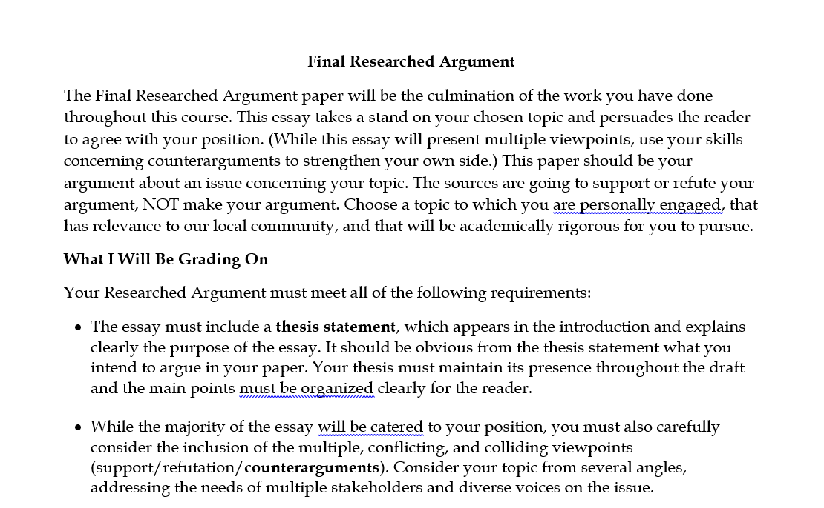

Slide 14
Take a few minutes to read the assignment instructions provided and choose a golden line and a muddy line.

Slide 15
Selecting Sources from a Database

Slide 16
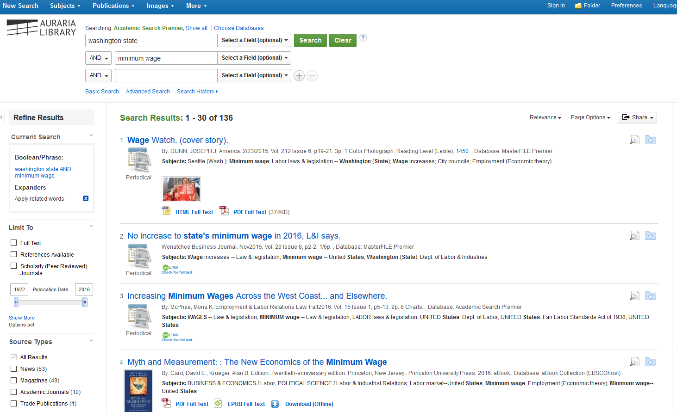

Slide 17
Using the results provided, circle three sources you’d like to look at more closely.
Put an X through three sources that you know won’t be helpful for you.

Slide 18
Using the Research Reading Log

Slide 19
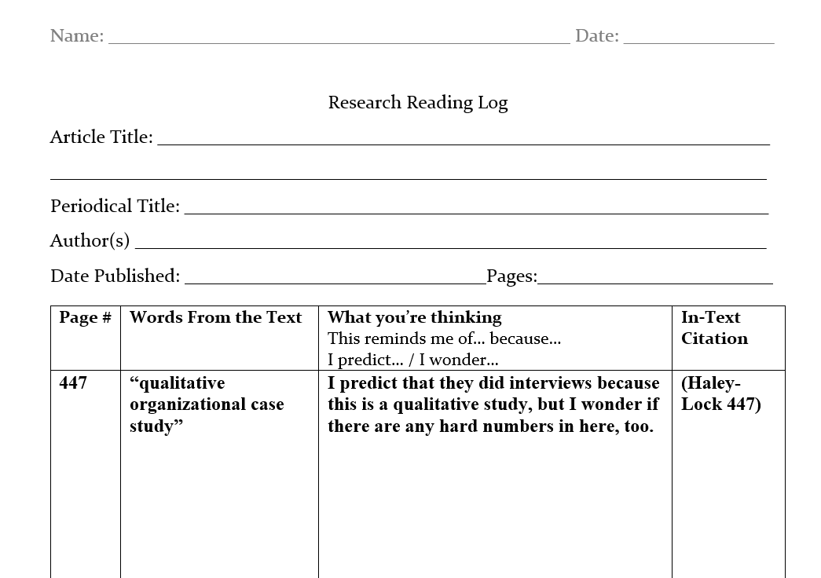

Slide 20
Using the Research Reading Log

Slide 21
Today’s Outcomes
So far today, you have…
Identified RA routines to use at various points in the research process
Modeled and practiced RA routines to use in the classroom
Visualizing the Research Process
Golden Lines/Muddy Lines
Source Selection Process (Choose 3, Exclude 3)
Research Reading Log
Reflected on how to integrate RA routines into existing research paper assignments

Slide 22
That’s it!
Thank you!
Zoe Fisher
Pedagogy & Assessment Librarian
University of Colorado Denver
zoe.fisher@ucdenver.edu

