Slide 1
Reading Apprenticeship
Adapted to English 101, English 101 Plus and Umoja English 101

Slide 2
What is Reading Apprenticeship?
Teachers using the Reading Apprenticeship framework regularly model disciplinary-specific literacy skills,
Help students build high-level comprehension strategies, engage students in building knowledge by making connections to background knowledge they already have, and provide ample guided, collaborative guidance.

Slide 3
Example of Read Aloud
See handout.

Slide 4
English 101 Fall 2016
How was Reading apprenticeship added to Fall 2016 English 101?
There were six novels students could sign up for
All the Rage by Courtney Summers
Death of Innocence: The Story of the hate crime that changed America by Mamie Till
Everything I never told you by Celeste NG
Black Elk Speaks by Black Elk
The Mayor of Castro Street by Randy Shilts
How does it feel to be a problem by Moustafa Bayoumi

Slide 5
Why were these novels chosen?
I did a survey of 2 years of English 101 students at both Green River College and Highline College of what topics they would like covered.
Here are the results:
The majority thought any novel that was more authentic would be most suitable for Civil Rights Movement conversations.
I use Death of Innocence: The Story of the Hate Crime that Changed America
I used to use The Help
Many female students added that they would like to talk more about “Rape Culture”
Many Asian students said they would love ANY novel about any Asian writer.
Some students from the LGBTQ community wrote that they would like to read something about a Gay Civil Rights Leader like Harvey Milk.
Many of my students that identify as Muslim wanted an authentic text about being Muslim in the United States
Finally, I had some suggestions from students who either a.) identified as Native American or b.) Environmental Activist students wanted a story about Native Americans, their experience and their respect for the land.

Slide 6
Survey asked these questions
1.) What topic would you like to cover more and why?
2.) Did you like the Civil Rights Movement topic? Why or why not?
3.) Did you appreciate my choice of The Help? Why or why not? Is there another novel I should use? Why?
4.) Do you appreciate a topic that you feel directly relates to you? Why or why not?

Slide 7
Other Class Materials
Islamophobia:
Native American Experience
* What Would you do TV Show Excerpts
Muslim Leader: Homophobia and Islamophobia Are Connected Systems of Oppression
Nihad Awad @NihadAwad
He Named Me Malala
Sherman Alexie Stories
Short Videos: Native American Experience
Dakota Access Pipeline On-line Reading Materials
“The Loss of Native America Lands:-short video

Slide 8
More Topics
Civil Rights Movement
LBBTQ Movement and more
Eyes on the Prize Documentary Excerpts
Langston Hughes Poems
Malcolm X, Martin Luther King Jr. Short Stories
“Still I Rise”
Timeline of Civil Rights Acts
“Take me to Church” by Hozier
“Born this Way”-Lady Gaga
Mathew Shepherd's Story via on-line resources
“Milk” starring Sean Penn
LGBTQ Timeline of Historic Events and Legal Changes

Slide 9
Final Topics and Materials
Rape Culture
Chinese American Experience
Donald Trump and “Grab Them…”
Jessica’s Feminized Atmosphere: Daily Show with John Stewart-short video clip
Women’s Liberation Movement Timeline
Myth of the Model Minority Article
Chinese American Movement in the United States
“I am not your Asian Stereotype”-Ted Talks
“Beyond Activism: Four Decades of Social Justice”

Slide 10
Novels and small group work
Activities in class:
Read Loud and Interacting with novels
Every 1.5 to 2 weeks a novel was introduced to the class.
Everyone one in the class received an excerpt from that novel.
I modeled to them how to read aloud.
Then a student would practice by reading aloud to their small group then to the whole class.
This way everyone would interact with each text even if they had picked a different novel.
This same process was applied to article that students found or poems or short stories that I brought in.

Slide 11
Reading Journals and Reader’s Apprenticeship
Text to Text: As you read-think about:
What does this text make you think about in relation to other texts you have read?
Write 1 paragraph (5-7 sentences)
Text to Self: As you read think about:
∙How does this text relate to you and your experiences?
∙ Write 1 paragraph (5-7 sentences)
Text to World: Are you read think about:
∙ How does the text you are reading relate to current event in society and the world?
Write 1 paragraph (5-7 sentences)

Slide 12
How were Reading Journals shared?
Small group read alouds
Whole group read alouds
Creation of a Reading Journal in small groups
Combining different novels to a small group to make connections with all major themes.
Refer to example of student work from English 101 Fall 2016

Slide 13
Clarification for Website “addresses”
I double checked all addresses were made up or “fake”
For all who were concerned about that aspect.
I still very much appreciate everyone’s advice as I will be sure to adapt more security and other copy right issues with website idea.
Thanks so much for all the feedback!

Slide 14
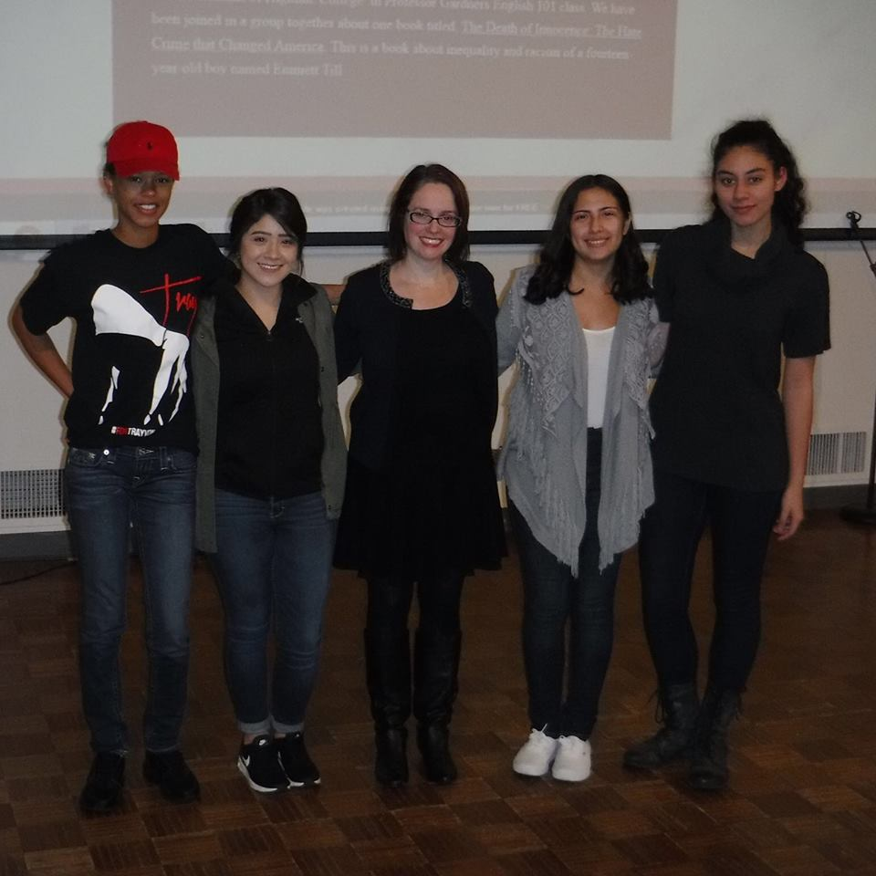
Example Websites from Fall 2016
English 101: Social Justice Novel Based
Civil Rights Movement:
Novel: Death of Innocence: The Story of the Hate Crime That Changed America by Mamie Till-Mobley
http://amcconville1.wixsite.com/socialjustice
Authors: Saudia Sanders | Monserrat Zumaya | AngeLynna McConville | Christie Martinez
Highline College
Small group photo

Slide 15
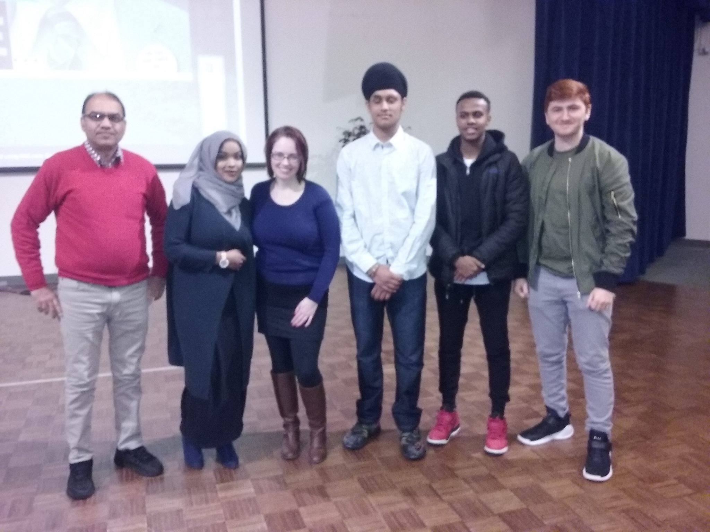
Another Perspective
Topic: Islamophobia
Small Group Photo
Novel: How does it feel to be a problem? By Moustafa Bayoumi
http://zafarkhalilov.wixsite.com/islamophobiafinal
Authors: Anil Kapoor, Mohit Dhillon, Hibo Omar, Abdullahi Abdi, Zafar Khalilov
Highline College

Slide 16
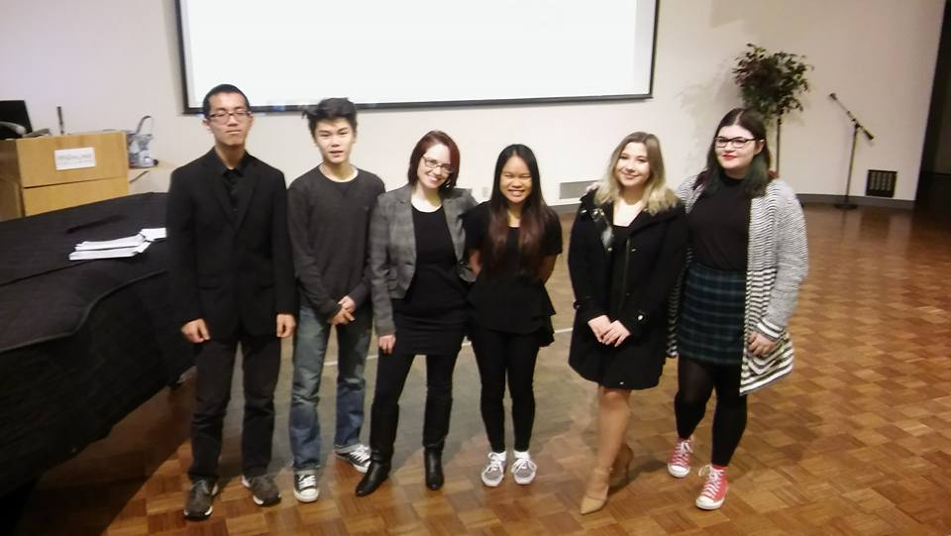
One last Example
Small Group Photo
Topic: Chinese American Experience
Novel: Everything I never told you by Celeste Ng
http://einty.weebly.com/
Authors: Jenna Yee | Kenneth Tran | Bonzy Nguyen | Angela Kalchik
Highline College

Slide 17
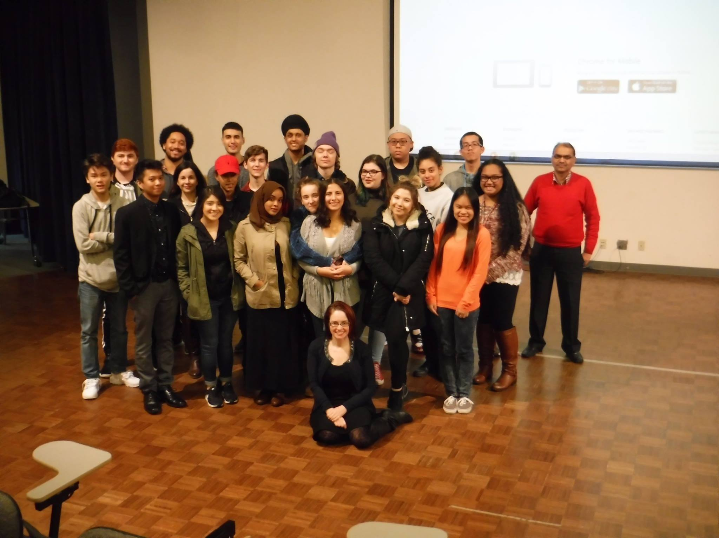
Classroom Community Photo

Slide 18
Improved Comprehension
Students wrote more in depth about complex novels in their weekly reading journals.
Students were more enthusiastic as a whole to complete their novel.
Students were more apt to apply RA to shorter readings that ranged from articles to short stories and poems.
Students were more active in discussions.

Slide 19
English 101 Plus and RA
The students chose from the following novels:
The Absolutely True Diary of a part-time Indian by Sherman Alexie
To be a Slave by Julius Lester
Enrique’s Journey by Sonia Nazario
When the Emperor was Divine by Julie Otsuka
All the Rage by Courtney Summers

Slide 20
Why these novels?
The Absolutely True Diary of a part-time Indian by Sherman Alexie-230 pages-
This is a funny and tragic story that I have used since I started teaching five years ago. Very popular with students
This is a young adult novel and since this is an English 101 Plus class (English 101 and 91 combined-there is a developmental aspect to Reading and Writing skills in students)
To be a Slave by Julius Lester-Lester tells the story of slaves in the USA and does so in a very honest way. One of the shorter novels: 156 pages
This is a young adult novel and since this is an English 101 Plus class (English 101 and 91 combined-there is a developmental aspect to Reading and Writing skills in students)

Slide 21
Continued….
Enrique’s Journey by Sonia Nazario-Immigration is a very relevant topic for today’s time period.
Though this story is a young adult novel is 300 pages and offers challenge if a student is looking for that.
When the Emperor was Divine by Julie Otsuka- 144 pages
Another story I have used since I started teaching and also very popular with students.
All the Rage by Courtney Summers-another young adult novel and 317 pages!
Challenging to read that many pages but the story is not too challenging.
Very tough relevant topic about rape culture.

Slide 22
Other Class Materials
To be a Slave Novel and “12 Years a Slave” Film
The Absolutely True Diary of a part-time Indian novel and film “Smoke Signals”
When the Emperor was Divine novel and “Snow Falling on Cedars” film and other article about Japanese American Internment
Enrique’s Journey and “What Would you do” excerpts and articles about Trump and Muslim Ban.
All the Rage novel and “Malala” film with additional articles about Trump and “Grabbing” women.

Slide 23
Novels and Small Group Work
Activities in class:
Read Loud and Interacting with novels
Every 1.5 to 2 weeks a novel was introduced to the class.
Everyone one in the class received an excerpt from that novel.
I modeled to them how to read aloud.
Then a student would practice by reading aloud to their small group then to the whole class.
This way everyone would interact with each text even if they had picked a different novel.
This same process was applied to article that students found or poems or short stories that I brought in.

Slide 24
Writing and Reading Apprenticeship
See attachment for student examples
First Example: What students did at first Journals 1-3 (Individuals)
Second Example: What students did the last few journals. ( Small Group Work)

Slide 25
Book Reviews and their final assignment
English 101 Plus will end in a Book Review and Presentation of each of their novels.
They will be placed in small groups.
They do have the option of working as individuals.
This is a timed assignment over a two day period.

Slide 26
How did RA help?
Students made stronger connections with:
a.) their novels and themselves
b.) each other’s novels
c.) each others individual stories as well
d.) went deeper in analysis on formal essays in class
e.) went deeper in weekly discussions in class

Slide 27
Umoja English 101 and RA
Novel of the quarter:
Death of Innocence: The Story of the Hate Crime that Changed America by Mamie Till
Other Readings and materials:
Excerpts from Post Traumatic Slave Syndrome by Dr. Joy Degruy
“Theme from English B” and “I, too sing America” by Langston Hughes
Eyes on the Prize Documentary Series Episodes 1-7
“Still I Rise” Maya Angelou

Slide 28
How was RA applied?
Text to Text: As you read-think about:
What does this text make you think about in relation to other texts you have read?
Write 1 paragraph (5-7 sentences)
Text to Self: As you read think about:
∙How does this text relate to you and your experiences?
∙ Write 1 paragraph (5-7 sentences)
Text to World: Are you read think about:
∙ How does the text you are reading relate to current event in society and the world?
Write 1 paragraph (5-7 sentences)

Slide 29
Umoja 101 Students….wrote 5 RA Journals
Wrote text to text, text to self and text to world. Their main focus was…
Mamie Till’s Novel Death of Innocence
Then….
Students discussed with each other in small groups
And…
With discussion and brainstormed with me one-on-one.
Finally,
Students did Writer’s Workshop with me in one-on-one meetings and also wrote more of their journals at this time.
We came up with more connections together.

Slide 30
See example of student reflection
Everyone will receive a copy of this.

Slide 31
How did this help?
Students made more connections with their own experiences and Mamie Till/Emmitt Till.
Students were able to see that connections with Mamie Till’s novel could be related to not just other novels, but documentaries, music videos, songs and short stories/poems.
Students were able to also make connections with Mamie Till’s novel and the world.
Finally, students could also go deeper in terms of analysis and this showed in each journal and in our weekly one-on-one meetings.

Slide 32
Thank you!
Questions?

