Slide 1
Exploring Mindset and Autoethnography through Reading Apprenticeship
Gretchen Robertson and Jennifer Boland
Skagit Valley College
Notes:
One of the questions I hear asked a lot when the topic of Reading Apprenticeship comes up is “How is this approach different from annotating or close reading?”
It’s a question that’s really important to answer correctly because it’s a question that lies at the heart of what makes Reading Apprenticeship so powerful and so revolutionary.
The answer, at least our answer, is that Reading Apprenticeship goes beyond practicing reading or learning how to read better. Reading Apprenticeship requires students to perform an in-depth study of themselves and their learning process. When we ask students to identify barriers on the page, we are asking them to examine gaps in their prior education. We are asking, “What is it you do not know?” and “What is it you do know” but we stop short of asking “Why is it that you do not know and do know?”

Slide 2
Contact Information:
Gretchen.Robertson@Skagit.edu
(360)416-4925
Jennifer.Boland@Skagit.edu
(360)416-7831
Canvas Commons Course Name:
Autoethnography and Mindset
Notes:
So how do we get students to dig deeper? One way to do this is through an autoethnographic study. Performing an autoethnographic inquiry through the lens of Carol Dweck’s concepts of mindset allows us to broach this second question with students. It is no secret that most students who walk through the doors of an Adult Basic Education office have been failed in some way by the education systems they have previously encountered. In order to serve them effectively, it is often essential that we as educators help them to identify these failings, especially since more often than not, these students have internalized these failings as their own, locking themselves into a fixed mindset that may have begun at a very early age. Identifying the inception of this mindset can be difficult work, but it is truly transformative.

Slide 3
What is Mindset?
Fixed Mindset
I’m either good at it or I’m not.
When I’m frustrated, I give up.
I don’t like to be challenged.
When I fail, I’m no good.
Tell me I’m smart.
If you succeed, I feel threatened.
My abilities determine everything.
Growth Mindset
I can learn anything I want to.
When I’m frustrated, I persevere.
I want to challenge myself.
When I fail, I learn.
Tell me I try hard.
If you succeed, I’m inspired.
My effort and attitude determine everything.

Slide 4
indset
Notes:
When I first started hearing about the concept of Mindset, I was suspicious. I had been observing the implementation of curriculum based around Paul Tough’s GRIT for about a year, and although the concept of GRIT can be powerful for students when taught thoughtfully, I believe it is too often implemented as a “pull yourself up by your bootstraps” regime. The distinction between resilience attribution and effort attribution is subtle, so unfortunately, “students can be successful through their previously-acquired resilience” can easily become “students are not successful because they aren’t trying hard enough.” Mindset seemed to me at the time to pose a similar threat. However, as I researched it more and read Dweck’s book, the concept of mindset began having a profound impact on myself as a learner and professional. What I found is that I had been raised in a Fixed Mindset household (explain). When I became aware of this, I was able to begin thinking as a life-long-learner. I knew that I had to share this opportunity with my students.
The first few quarters I taught Mindset, it was just OK. Students liked the topic, but it was difficult to get students to recognize their own fixed mindsets. As a result, I observed little impact on self-talk and student learning. Students weren’t applying the concept to themselves as learners. What I realized is that students were lacking metacognition around Mindset. They were not able to recognize their own fixed thinking. I worked on applying RA routines to Mindset, which improved outcomes, but the assignments still felt isolated. It wasn’t until Jennifer began talking about autoethnography, that things really got exciting.

Slide 5
What is autoethnography?
auto / ethno / graphy
Autoethnography is the act of writing about oneself in order to explore and understand one’s culture.
Notes:
Autoethnography is the act of writing about oneself in order to explore and understand one’s culture.
In autoethnographies students balance observations of their daily lives and memories of their childhoods with interpretations of their current beliefs. When approached through the lens of mindset, students can use their autoethnoghaphic study to identify current and past influences in their lives that may have modeled or reinforced fixed mindsets, particularly when it comes to education and learning.
For example, it is useful to recognize one’s fixed mindset toward a specific skill set (like math or spelling), but the transformation to growth mindset cannot truly take place until the student uncovers the origin of this mindset.

Slide 6
You Are Here
Teachers, Schools, Classes
Parents and Family
Your Emotions
Your Brain
Culture and Traditions
Hometown
Friends and Mentors
Jobs, Bosses, Co-workers
Neighborhood
Notes:
We realized there was a big difference between talking about the people and communities that might influence your mindset and actually studying them through observations, interviews, and remembrances.

Slide 7
indset
Environment
Personal
Effort
Training
Experience
Upbringing
Notes:
Gretchen introduces the 5 pieces that make up mindset.

Slide 8
Upbringing
Notes:
Play Story Corps and provide example of 25 word summary and evidence/interpretation log.

Slide 9
https://www.youtube.com/watch?v=MqXTlnTSzmo

Slide 10
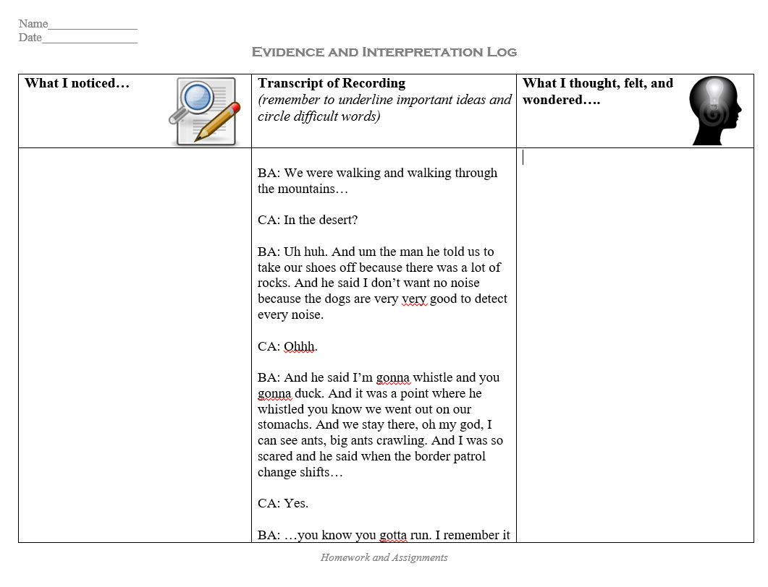

Slide 11
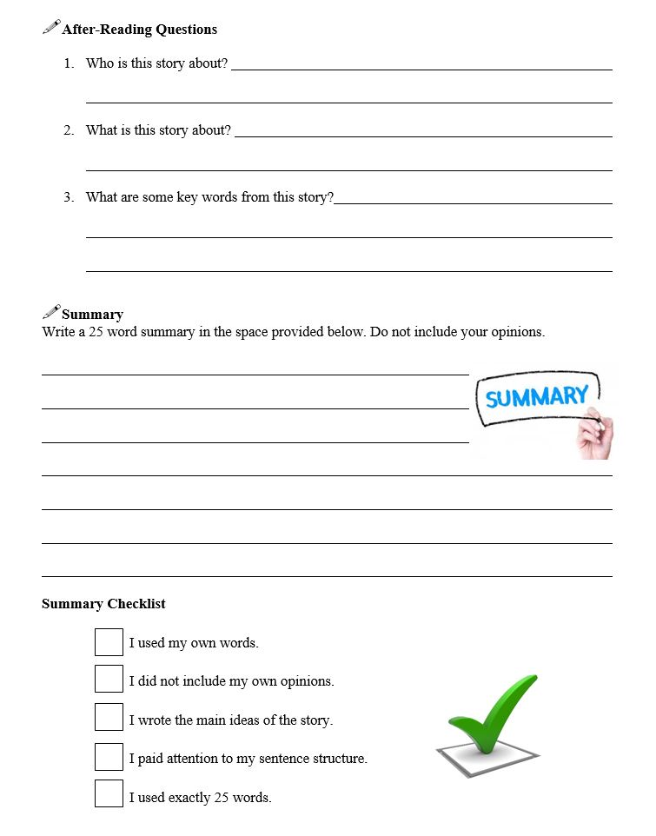

Slide 12
indset
Environment
Personal
Effort
Training
Experience
Upbringing

Slide 13
Environment
Notes:
Show participants observation journal entry.

Slide 14
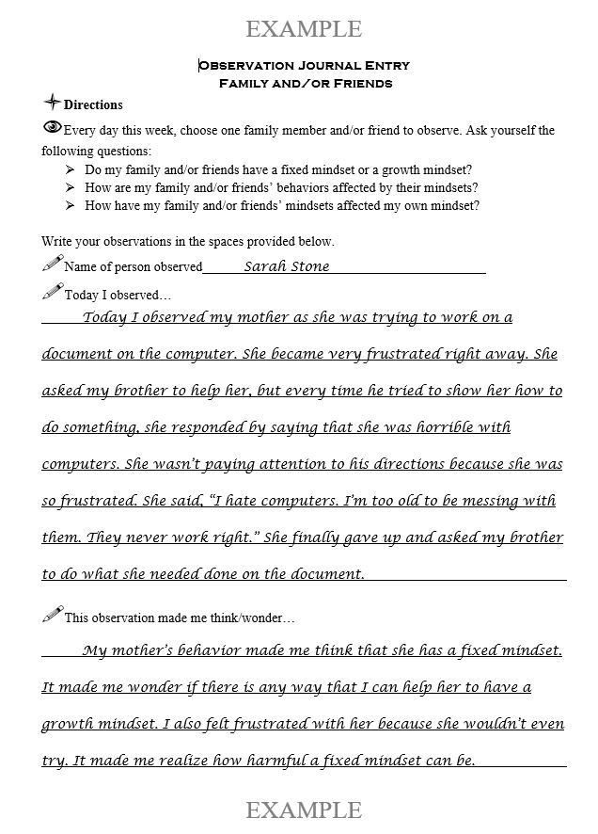

Slide 15
indset
Environment
Personal
Effort
Training
Experience
Upbringing

Slide 16
Experience
Notes:
Participants interview each other.

Slide 17
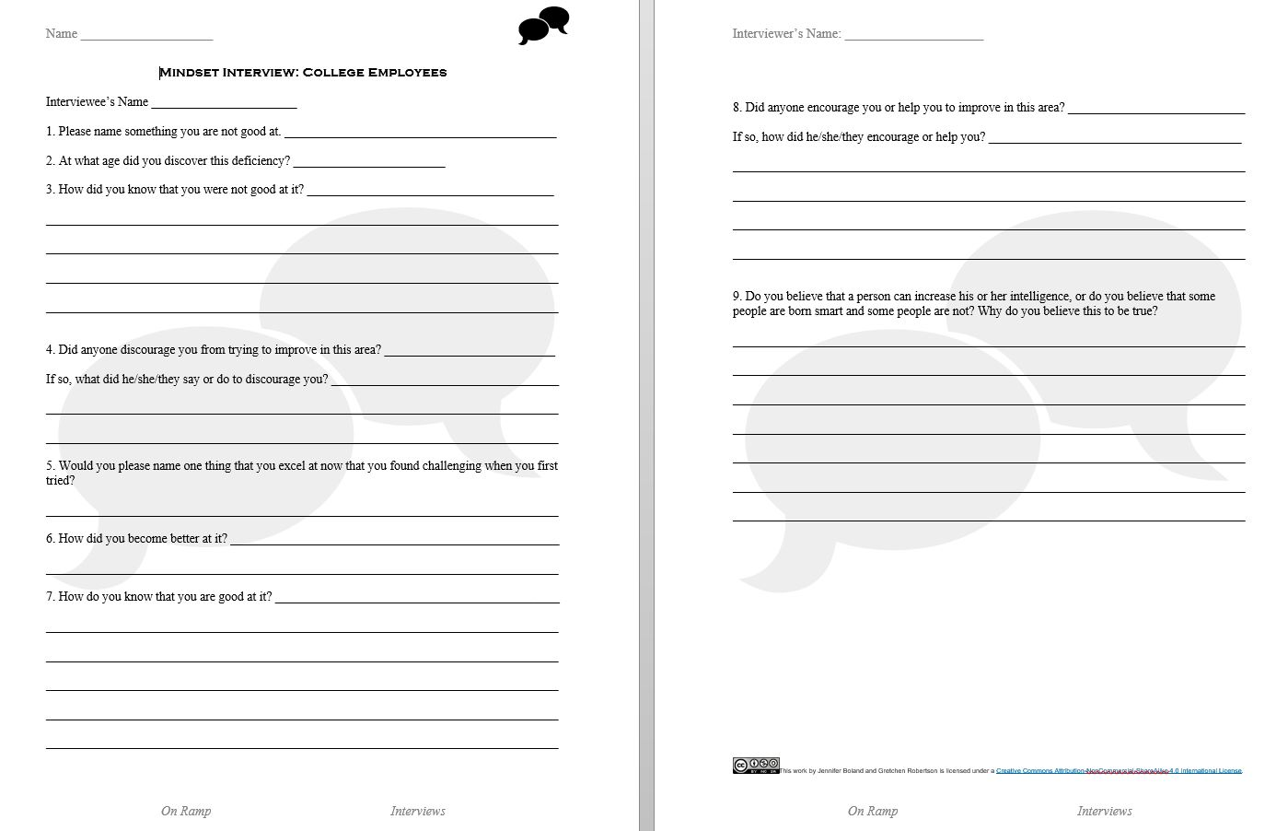

Slide 18
indset
Environment
Personal
Effort
Training
Experience
Upbringing

Slide 19
Personal
Effort
Notes:
Discuss the connection between RA routines and personal effort.
Student realizations?
Difference between the process of teaching personal effort through Mindset and personal effort through GRIT?
Possibly share personal effort slide from one of our student’s Mindset Presentations?

Slide 20
Notes:
Difference between grit and personal effort in mindset.

Slide 21
indset
Environment
Personal
Effort
Training
Experience
Upbringing

Slide 22
Training
Notes:
Discuss guest speakers and the impact that the speakers had on students. Transition discussion

Slide 23
indset
Environment
Personal
Effort
Training
Experience
Upbringing

Slide 24
REferences
Atkinson, D., & Sohn, J. (December 01, 2013). Culture from the bottom up. TESOL Quarterly: a Journal for Teachers of English to Speakers of Other Languages and of Standard English As a Second Dialect, 47, 4, 669-693.
Camangian, P. (2010). Starting with self: Teaching autoethnography to foster critically caring literacies. Research in the Teaching of English, 45(2), 179-204.
Gagnon, J.K. (2011). Fusing intercultural and expressivist pedagogies in a mixed composition context. (Master’s Thesis). Retrieved from http://csueastbay-dspace.calstate.edu/bitstream/handle/10211.5/45/jerome.k.gagnonthesis.pdf?sequence=1.
Lapidus, A., Kaveh, Y.M. & Hirano, M. (2013). ESL Teachers/ESL Students: Looking at autoethnography through the lens of Personetics. L2 Journal, 5(1). Retrieved from http://www.escholarship.org/uc/item/7b733911.
Park, G. (July 01, 2013). Writing is a way of knowing': Writing and identity. ELT Journal, 67(3), 336-345.
Pratt, M. L. (January 01, 1991). Arts of the Contact Zone. Profession, 33-40.
Sykes, B. E. (February 01, 2014). Transformative Autoethnography: An examination of cultural identity and its implications for learners. Adult Learning, 25(1), 3-10.

