Slide 1
Metacognition & Mindfulness: Academic Literacies for the 21st Century
A Regional Reading Apprenticeship Conference
March 11-12, 2016

Slide 2
Reading Apprenticeship Dimensions
Social [ Act One ]
Cognitive [ Act Two ]
Personal [ Act Three ]
Knowledge Building [ Act Three ]
Semantic Assessment Model – S.A.M.
Act One: Orientation
Act Two: Exploring Tensions and Creating Blueprints and Maps
Act Three: Confluence of Inspiration, Imagination, and Poor Reasoning

Slide 3
Reflection Principle: Unpacking Assumptions about Reading and Thinking in Three Acts
Act #1
Orientation to the primary goals of reading, thinking and writing strategies. Collectively we are all in search of…
--constructing meaning
--developing interpretations
--exploring context and cultural assumptions
“In the case of books, the point is not to see how many of them you can get through, but rather how many can get through to” you
Orientation to Cultural Literacy; Reading, Thinking, and Writing
Mortimer Adler
Confluence of Inspiration, Imagination, and Poor Reasoning
ACT #2
Exploring Tensions in a rehearsal space
The space is an invitation for students to join in ongoing conversations evaluating an author’s frame of reference, a working thesis, lines of argument, and burden of proof
ACT #3
Evaluate the Differences Between Being Skeptical vs. Being Open Minded
Skills—should …
--be clearly defined
--reinforced in rehearsal spaces
--linked to the overall learning process
Irrational Thinking
Straw Person
Argument
Wishful Thinking
False Dilemma Argument
Circular Reasoning
Authority Worship
Burden of Proof
Creating Blueprints and Maps allows students to build their own metacognition pathways for future reading habits and strategies, these may include:
--evidence logs --chunking texts
--reading notes --summarizing
Habits—can …
--allow for the ongoing practice of reading—thinking—writing
Semantic Assessment Model--SAM Reading Engine version 1.0
David Ortiz: Cascadia College

Slide 4
Reflection Principle: Unpacking Assumptions about Reading and Thinking in Three Acts…
ACT One: Social Dimension
Orientation to the primary goals of reading, thinking, and writing. An introduction to developing a “purpose” for the metacognitive activity.
The purpose may be influenced by disciplinary views on thinking, writing, and reading within a specific arrangement of courses…

Slide 5
Balancing Act
Context and Purpose…
01<!DOCTYPE HTML>
02<html>
03<body>
04
05 <p>Header...</p>
06
07 <script>
08 alert('Hello, World!')
09 </script>
10
11 <p>...Footer</p>
12
13</body>
14</html>

Slide 6
Reflection Principle: Unpacking Assumptions about Reading and Thinking in Three Acts
Act Two: Cognitive Dimension
Exploring Tensions in a rehearsal space
The space is an invitation for students to join in ongoing conversations evaluating an author’s frame of reference, a working thesis, lines of argument, and burden of proof…

Slide 7
Balancing Act
Exploring the tensions between information and knowledge
In the digital age…
--documents follow patterns of “Fixity”
--information follow patterns of “Fluidity”
In the digital age…
--where do rhetorical messages reside?
The Social Life of Information by John Seely Brown and Paul Duguid

Slide 8
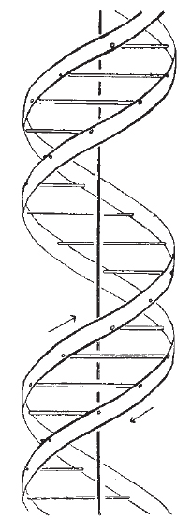
Reflection Principle: Unpacking Assumptions about Reading and Thinking in Three Acts
Act Two: Cognitive Dimension
Creating Blueprints and Maps
Developing reading guides allow
students to build their own
metacognition pathway for
future readings habits and
strategies

Slide 9
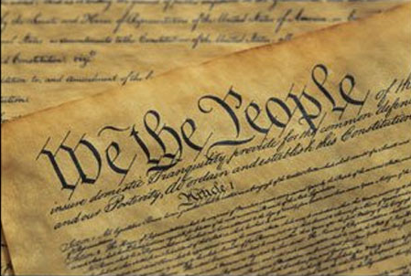
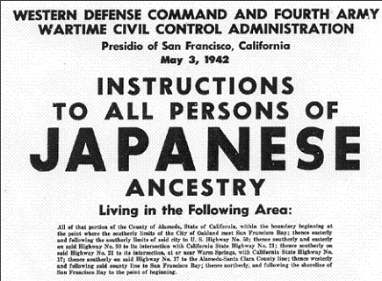
Balancing Act
When should you use reading skimming strategies and when should you use strategies of deep analysis?

Slide 10
Reflection Principle: Unpacking Assumptions about Reading and Thinking in Three Acts
Act Three: Knowledge Building Dimension
Skills and the habits for using them should be ongoing rehearsals for building knowledge and judgment

Slide 11
Reflection Principle: Unpacking Assumptions about Reading and Thinking in Three Acts
Act Three: Personal Dimension
Managing Poor Reasoning Strategies
--Straw Person Argument: is a fallacy that promotes substituting a distorted, exaggerated or misrepresented version of a position or fact.
--Wishful thinking: is a fallacy that promotes believing in something that is not true but, appears true based on our desire to make it appear to be true

Slide 12
Reflection Principle: Unpacking Assumptions about Reading and Thinking in Three Acts
--False Dilemma: is a fallacy that promotes an either/or proposition
--Circular Reasoning: is a fallacy that occurs when individuals attempt to prove a claim by pointing to another claim that ultimately is supported by the original claim
--Authority Worship: is a fallacy based on someone’s status, wealth, or prestige making claims that are supported by their popularity

Slide 13
Reflection Principle: Unpacking Assumptions about Reading and Thinking in Three Acts
--Burden of Proof: is a fallacy promoted by individual making exceptional claims only they can support and defend
Good Thinking by Guy P. Harrison

Slide 14
Thank- you
Now—Start Building…
David Ortiz
Cascadia College

