Slide 1
Beyond the Evidence Log

Slide 2
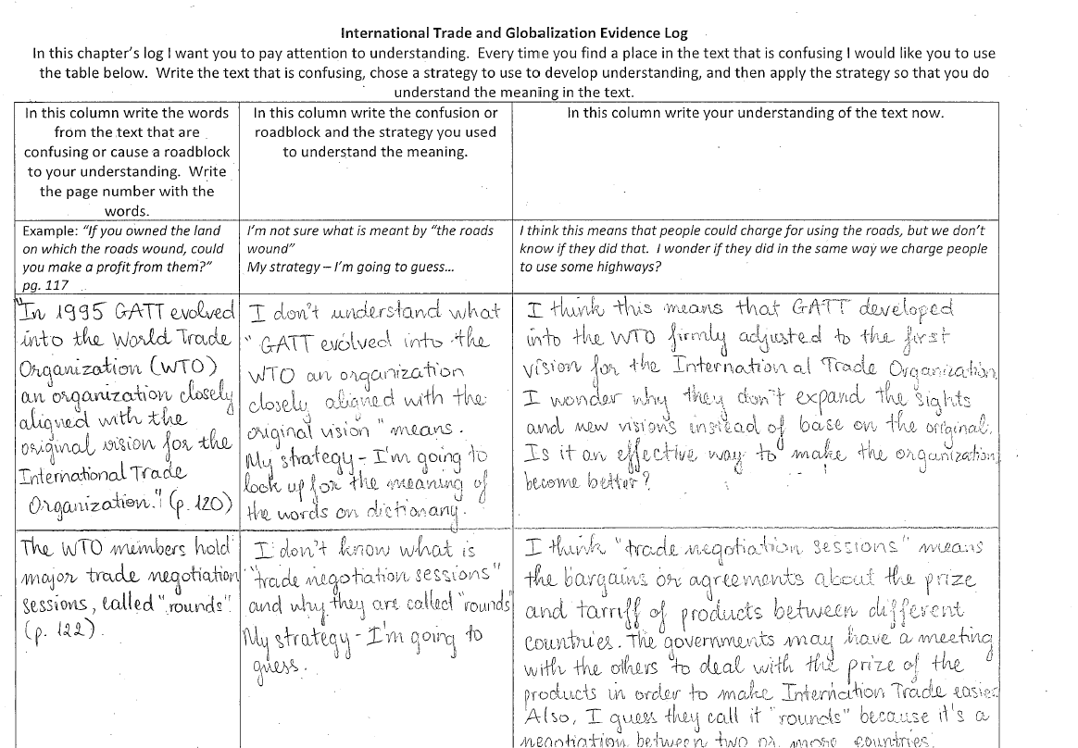
What is an Evidence Log?
Engages students with text
Supports metacognitive development
Students chose text and learn to value
their own thoughts

Slide 3
Why evidence logs?
Questions they address:
How do you know students have read?
How do students remember their thinking as they read?
How do students connect to what they read?

Slide 4
Evidence Logs in a
High School Completion Current Issues Class
Golden Lines
Connections
Answers to your research questions
Roadblocks

Slide 5
The Roadblock Log
Purpose –help students actively apply strategies to problem solve the reading.
To helps students build vocabulary.
To help students build knowledge of the content.
To support learning across the dimensions.
How they worked:
Students read outside of class and brought the logs to class. In groups of 4 students shared roadblocks and discussed their strategies and what they figured out. (Personal, Social, Cognitive Dimensions)
They also discussed parts of text they didn’t figure out and they problem solved together. (Social Dimension, Cognitive Dimension)
Then, the groups chose a part of the text they couldn’t yet understand and those became the topics we covered in class. (Knowledge building dimension)

Slide 6
Ideas for Grading
Chose text from eight different sections. 3 pts Completed 3 pts
Chose text that inspired thinking 2 pts Clearly you did – variety of thoughts and connections represented. 2pts
Wrote thoughts, connections, questions, etc. Wrote more than one sentence. Explained questions and comments. Wrote clearly and thoroughly. 6 pts Yes – you did really well here – explaining opinions, using examples… Nice work 6pts
Used feedback from previous log to develop this log. 4pts You did a great job incorporating my feedback from last time. I can see that you explained more clearly and used examples. Well done! Continue to do what you did this time. Keep consistent with explaining your thoughts. 4pts

Slide 7
Other considerations for making logs work
Modeling the first one
Consistency
Expectancy
Routine

