Slide 1
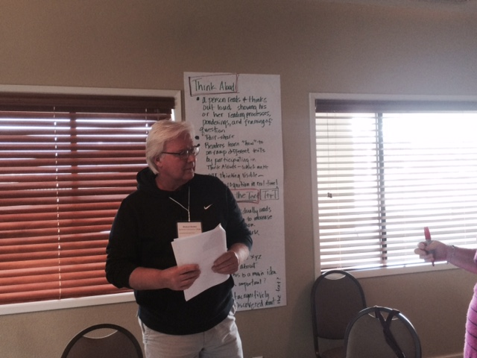
A Three-minute assessment and a few aha’s
Michele Lesmeister
March 11, 2017

Slide 2
How can we show our results of our classroom disciplinary reading work?
Curriculum Embedded Reading Assessment (CERA)
CASAS Reading Test
Metacognitive Awareness of Reading Strategies Inventory (MARSI)
Test of Silent Word Reading Fluency (TOSWRF-2)
Artifacts and testimonials
Data gathering seems to be the new normal for proving that some pedagogical approach works.

Slide 3
What is difficult about measuring reading?
We have tried to find an assessment to accomplish our goals of measuring reading improvement other than passing grades.
We find that in ABE and ESL/ELA classrooms that have Reading Apprenticeship routines embedded in them, we can track their growth through the CASAS levels and the gains are significant.
We tried using the using a variety of tools, from embedded reading tests to Metacognitive Awareness of Reading Strategies Inventory (MARSI).

Slide 4
The Metacognitive Awareness of Reading Strategies Inventory
The Metacognitive Awareness of Reading Strategies Inventory (MARSI) was developed by educational researchers Mokhtari and Reichard (2002). This survey lists 30 different strategies readers use to make sense of texts .The inventory asks students to rate the frequency with which they use these strategies in academic reading, along a 5-point scale from 1 (Never) to 5 (Always). Student responses are grouped into average scores for three areas – Global Reading Strategies, Support Reading Strategies, and Problem-Solving Strategies, along with an overall score. The scoring scale: High = 3.5 and up, Medium = 2.5-3.4, Low = 2.4 and below.

Slide 5
Why MARSI did not work for us?
After using the Metacognitive Awareness of Reading Strategies Inventory (MARSI), we found the inventory results were too dependent on their own labels of reading strategies. labels when students outcomes were measured.
Faculty may not use the terms on the inventory.
One aha was that students may actually report more truthfully and knowledgeably in their post-tests as their awareness of reading strategies improved.

Slide 6
What are we looking for anyway?
What are the reading levels in our classrooms?
An early warning for faculty, so they know that students need scaffolding, modeling, and embedded reading routines--removing their expert blind spot and engaging students.

Slide 7
Test of Silent Word Reading Fluency 2
The TOSWRF-2 has six components: this manual, the supplemental Administration and Scoring Instructions, and four equivalent forms (A, B, C, and D). The test provides raw scores, standard scores, percentiles, and age/grade equivalents. It was normed on a representative sample of 2,429 students ranging from 6 years 3 months to 24 years 11 months in age.
Cost $ 297.00

Slide 8
What is measured?
The TOSWRF-2 is primarily a measure of word identification, word comprehension, and reading speed (also known as silent reading fluency).
Because its scores reflect competence in so many aspects of reading, its results can also be taken as a valid estimate of general reading ability and can be used to identify poor readers with confidence.
For our data, we want to track the students’ raw scores pre and post-tests because we want to see how the students gain from classroom scaffolding and teacher awareness of their reading scores.

Slide 9
What do students see and do?
Students are presented with 220 unrelated printed words, ordered from pre-primer to adult-level, with no spaces between the words. For example:
DIMHOWFIGBLUE
Students draw lines between each word for 3 minutes.
DIM HOW FIG BLUE

Slide 10
How is the test administered?
Introduce this test to students and provide explanation for using it.
Students fill out demographics section of test.
Review how to mark the test.
Give a practice test
Give the test (3 min.)
Score and tally and send to instructors with suggestions.

Slide 11
Our Findings from Winter 2017
Grade Level 0-4 | Grade Level 5-9 | Grade Level 10+
46 students | 59 students | 63 students
27.3% | 35.2% | 37.5%
We have low-skilled reading students in academic courses.
Buckets are somewhat equal.
Very poor readers improved most often.

Slide 12
What have we done with the results?
Sent the pre-test scores with student data to each faculty member
Used ongoing Reading Apprenticeship professional development to support faculty
Faculty appreciated information and help.
Faculty are given an early warning about students’ reading levels and can offer scaffolds and routines to support engaging their texts.

Slide 13
Questions and Discussion
For more information on the TOSWRF-2
http://www.proedinc.com/customer/productView.aspx?ID=6159

